Slide 1
Capstone Project
The Battle of Neighbourhoods
Selecting the best option to open a Sushi Bar in Manhattan, New York.

Slide 2
Introduction
The City of New York is famous for its excellent cuisine. It's food culture includes an array of international cuisines influenced by the city's immigrant history.
Sushi bars have become so popular in the United States, now it seems that there is one on every corner, not only in major cities but also in smaller cities. Starting a Sushi bar can be a great business opportunity, but you need to distinguish yourself from others to enjoy long-term success.

Slide 3
Business Problem
I want to open my business in Manhattan area, keeping in view, I define potential neighbourhood based on the number of Sushi bars which are operating right in each neighbourhood. Manhattan has full potential but also is a very challenging district to open a business because of high competition. New Sushi bar should be open in an area that inadequate neighbourhood in this way my Sushi bar can attract more customers. Therefore, this analysis is necessary to ensure that we will have enough customers and that we will not so close to other Sushi bars.

Slide 4
Data Selection
To identify the characteristics of our competitors' venues in Manhattan, we would first need to find out the number of Sushi bars in Manhattan currently and their location.
We then used Google Map API to find their geographic coordinates based on their postal code addresses.
In Manhattan, there are 1763 Sushi bars are currently operating.
https://geo.nyu.edu/catalog/nyu_2451_34572 (1763, 7)

Slide 5
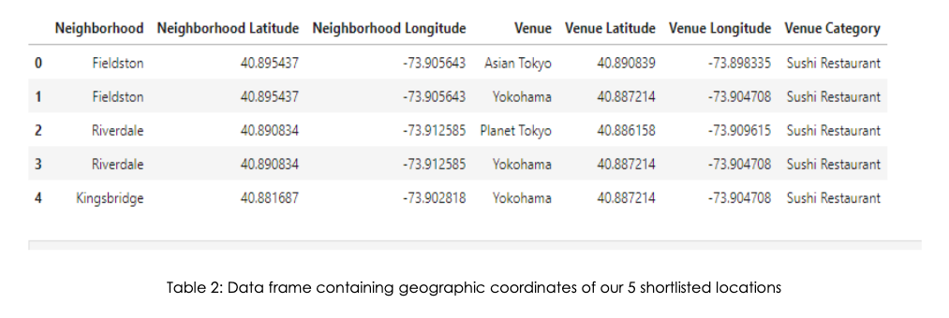
Data Selection
Next, we also used Google Map API to find their geographic coordinates of the 5 locations shortlisted for our Sushi bar;

Slide 6
Methodology
Addresses are converted into their equivalent latitude and longitude values.
Foursquare API is used to explore neighbourhoods' in Manhattan, New York.
After that, explore function to get Sushi bar categories in each neighbourhood.

Slide 7
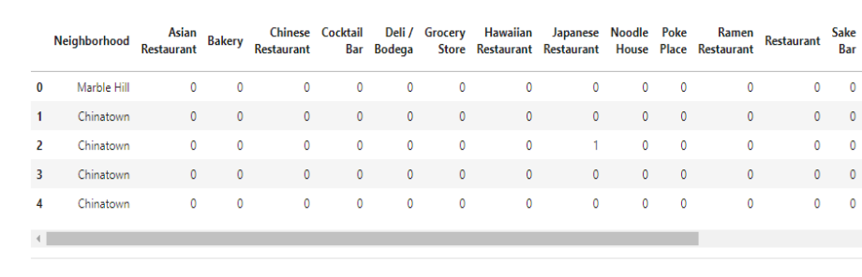
Methodology

Slide 8
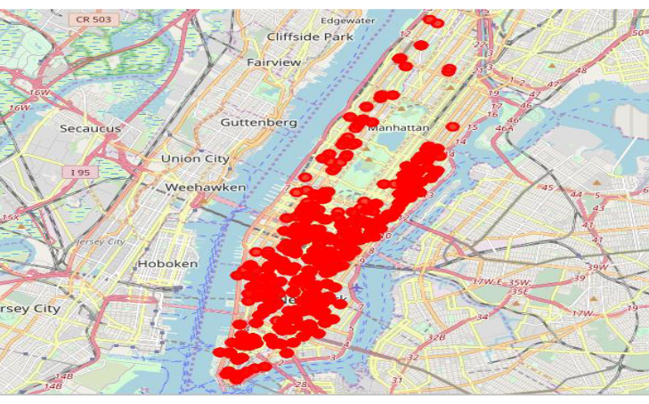
Methodology
* Sushi bars in Manhattan

Slide 9
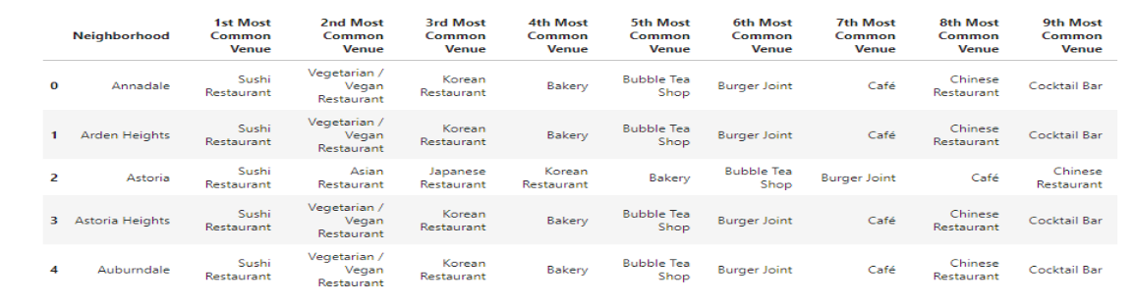
Methodology
Then using this feature to group the neighbourhoods' into clusters K-means clustering algorithm will be used to complete this task. And also, the Folium library to visualize the neighbourhoods’ in Manhattan and its emerging clusters.

Slide 10
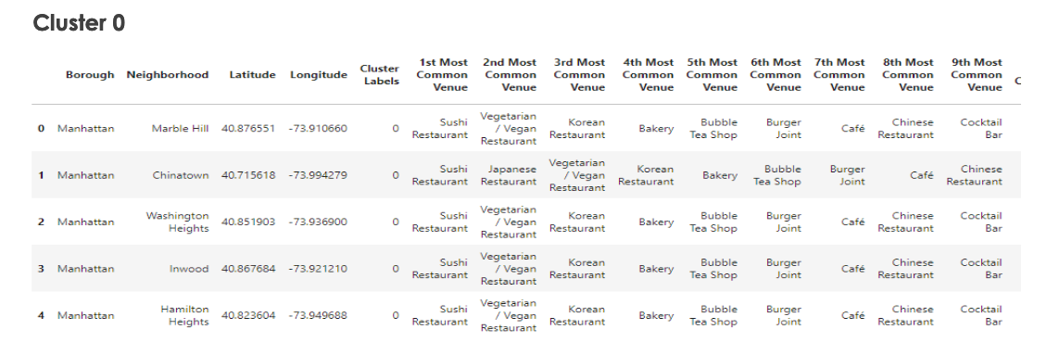
Results
Using K-mean to clustering data area with less number of Sushi bars;

Slide 11
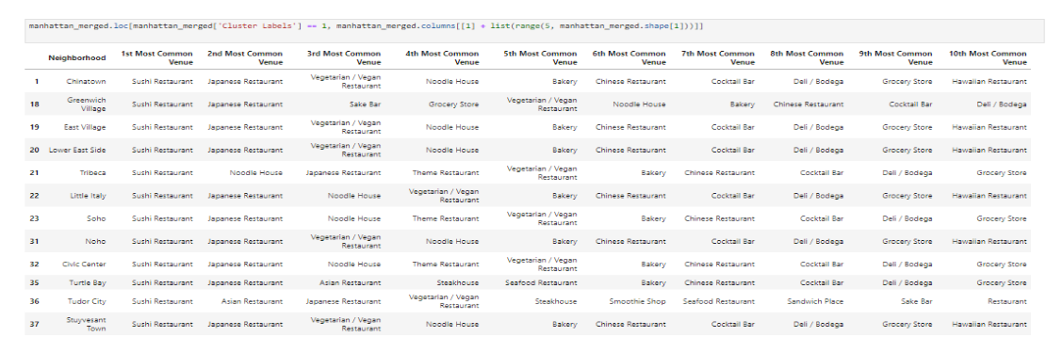
Results
Cluster 1

Slide 12
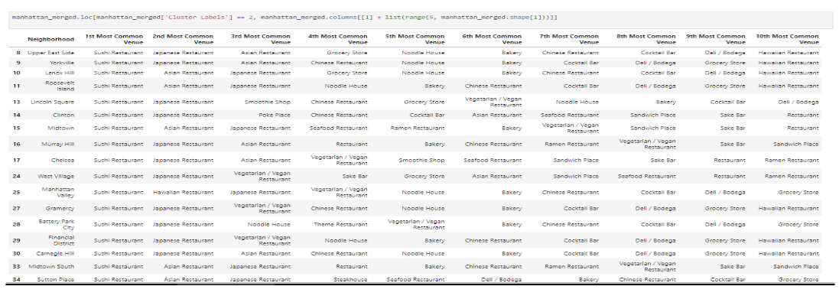
Results
Cluster 2

Slide 13
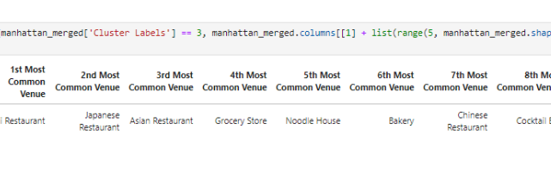
Results
Cluster 3

Slide 14
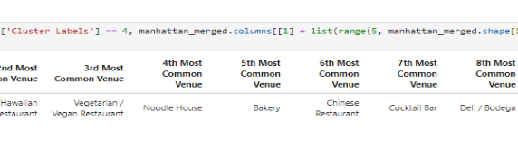
Results
Cluster 4

Slide 15
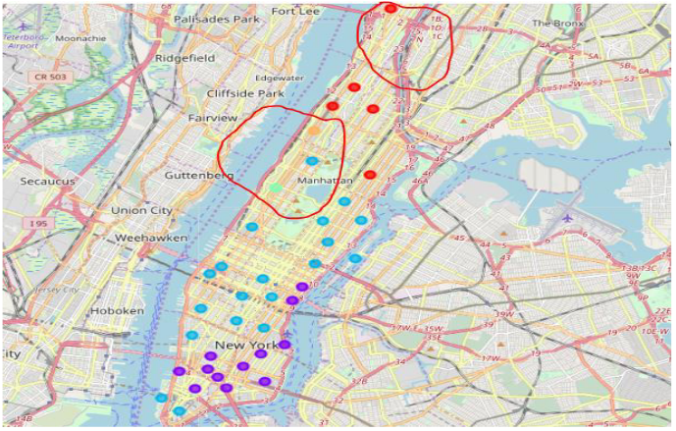
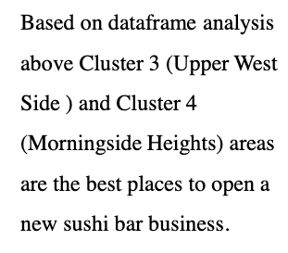
Results

Slide 16
Discussion
This analysis is performed on limited data, results may vary. But if good amount of data is available there is opportunity to get better results.
01
There is high competition in Midtown and Sohoso it is very risky to open business in these areas.
02
Central Harlem has also potential where closes to Morning side Heights area.
03
More detailed analysis is suggested by adding other factors such as transportation, demographics of inhabitants, etc.
04

Slide 17
Conclusion
Although all goals of this project are met, there is definitely AN opportunity for further improvement.
Apart, goals of the project, this can easily be extended into a fully functional application that could support the entrepreneurs’ in opening a new business in an unknown location.

Slide 18
Thanks.

